Slide 1
Company Overview and General Capabilities:

Slide 2
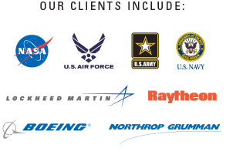
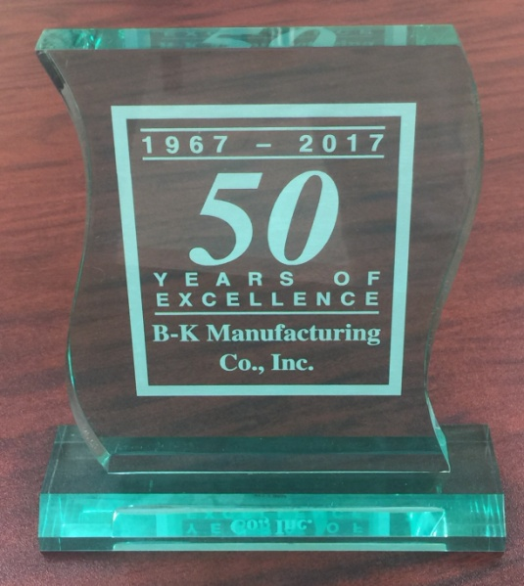
Company Background and History
B-K Manufacturing Co. Inc. (DBA BK Aerospace) is a woman owned small business (WOSB), self certified small disadvantaged business (SDB).
BK has been in business since 1967 and is celebrating its 50th anniversary in 2017.
BK specializes mainly in complex and precision machined hardware, integration, engineering, testing, and design.
BK does work for some of the most demanding aerospace and defense contractors and government agencies in the business, and have been doing so for 50 years.

Slide 3
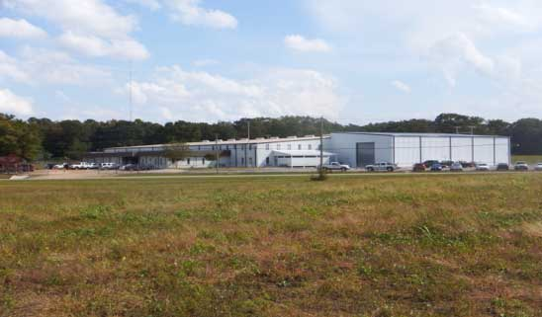
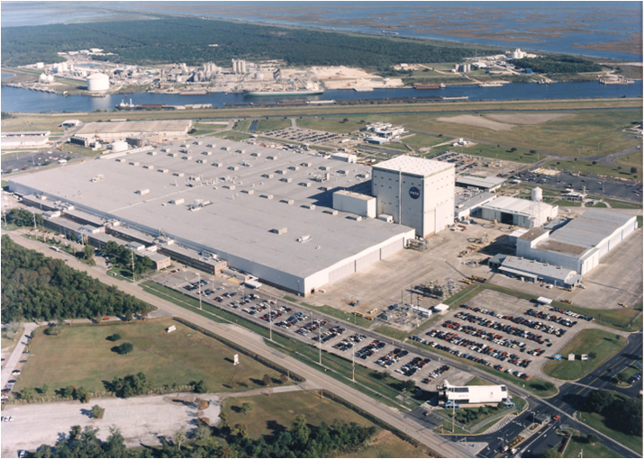
Facilities
Arab, AL
- BK Aerospace was founded, and is headquartered in, Arab, AL. Arab is located just south of Huntsville, AL and is in close proximity to Redstone Arsenal and NASA Marshall Space Flight Center. Our headquarters boasts 75,000 square feet of state of the art, climate controlled facilities
New Orleans, LA
- BK is also currently a tenant at the NASA Michoud Assembly Facility (MAF) in New Orleans, LA. BK currently has an office and several full time employees on-site at MAF. When needed, BK has access to over 100 thousand square feet at MAF.

Slide 4
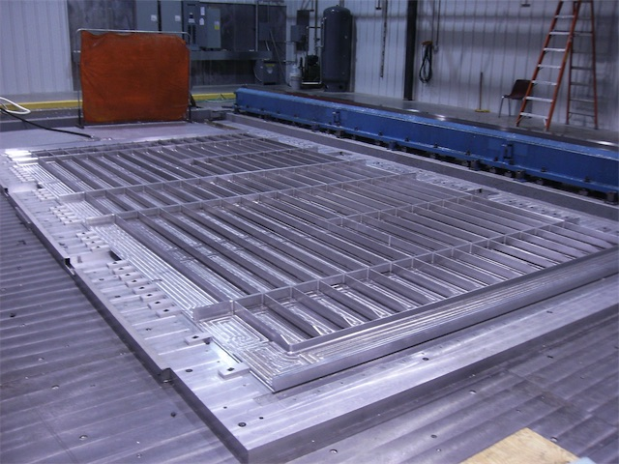
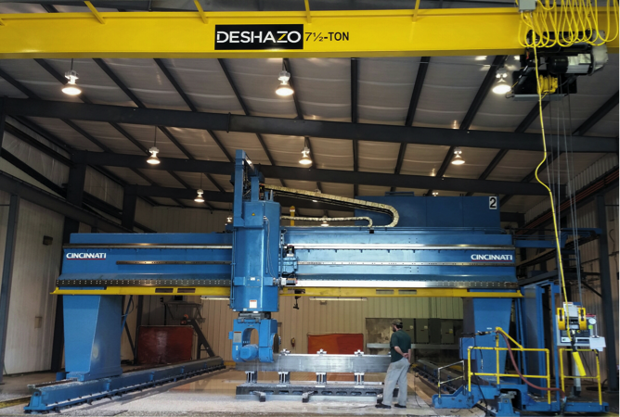
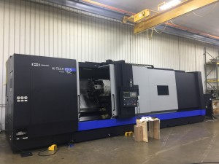
Large Scale Machining and Integration
BK has a large variety of CNC machining equipment, but one of our main differentiators is in our ability to machine and produce large scale items.
BK possesses several large envelope machines and has a network of overhead cranes and forklifts to make machining and integration of large items more manageable.
Large machined panels for SLS rocket
Large envelope Cincinnati 5 axis gantry milling machine
Large CNC turning machine with live tooling

Slide 5
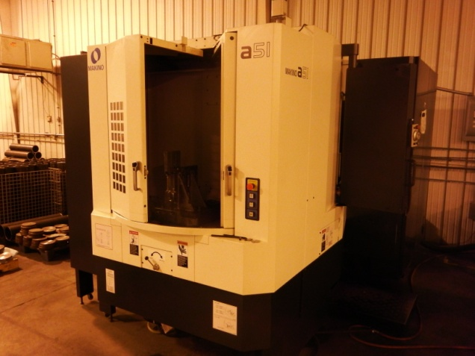
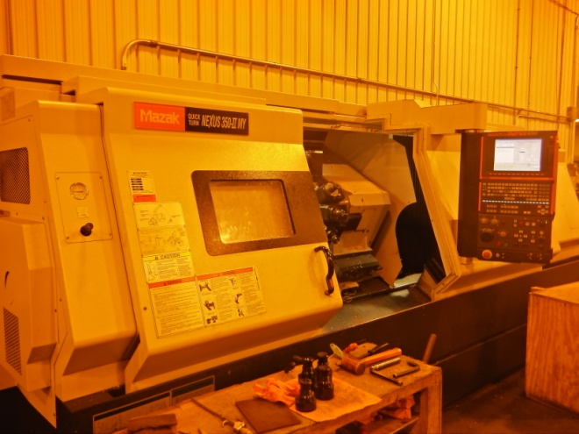
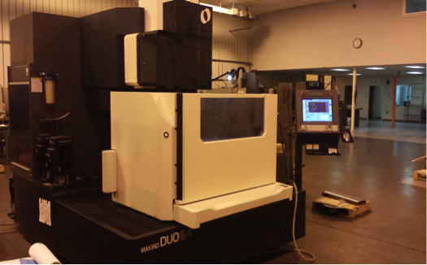
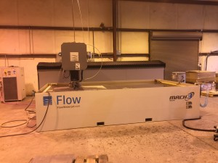
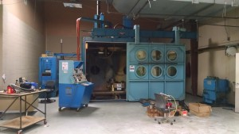
CNC shop equipment – various sizes
CNC Lathe (turning) – 3,4, & 5 axis
CNC Milling – 3,4,& 5 axis
Wire EDM
Water jet machining
Electron Beam Welding

Slide 6
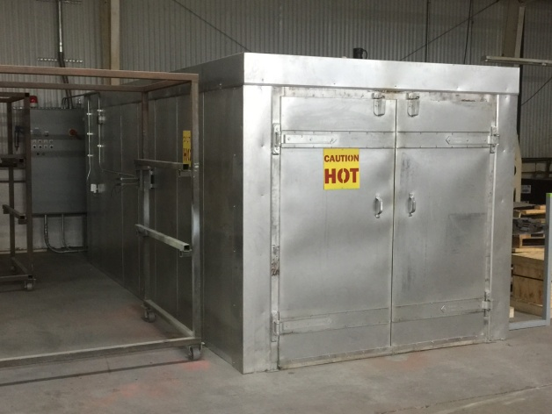
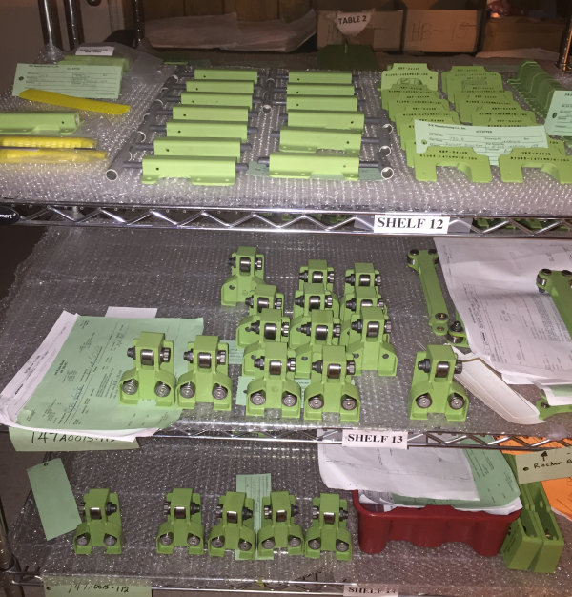
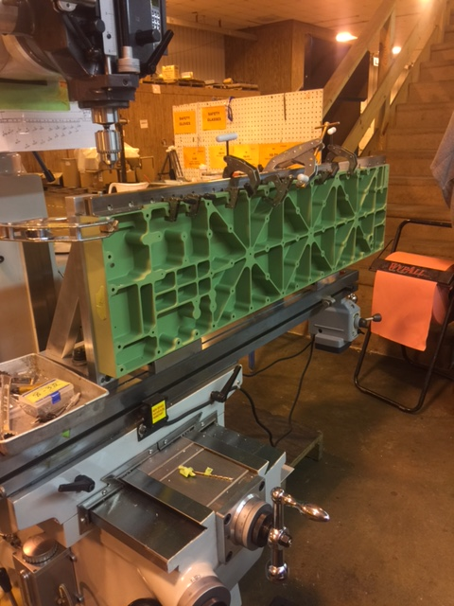
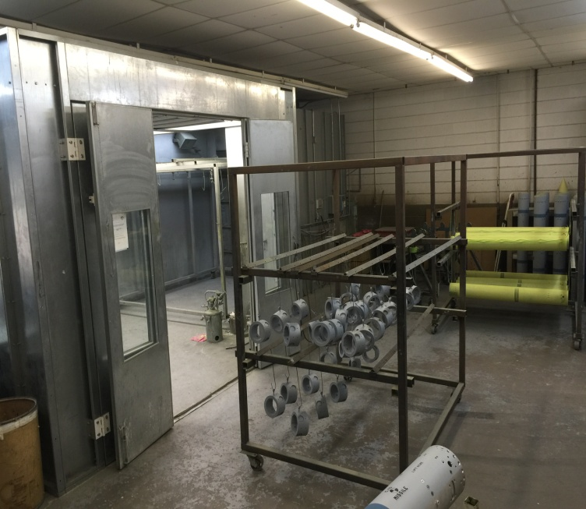
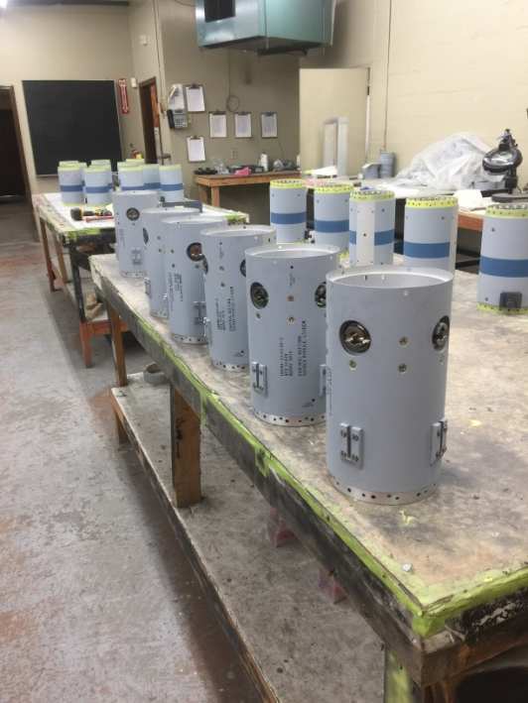
Assembly, Paint, and Special Processes
BK assembly facilities in-house, as well as a 12,500 square foot paint/special process facility.
Our in house paint facility has a large humidity controlled
paint booth, curing ovens, assembly and storage space.
Special process capability includes shot peen,
bead blast, and Dye Penetrant.

Slide 7
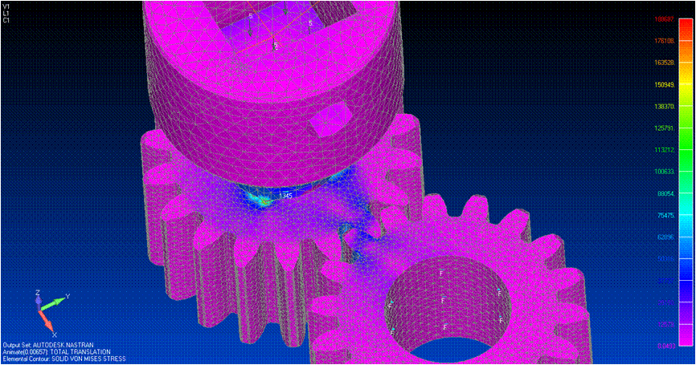
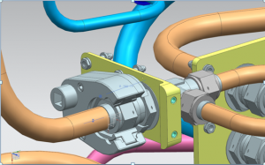
Engineering, Testing, and Design
BK has a complete engineering staff consisting of:
-Mechanical Engineering
-Manufacturing Engineering
-Electrical Engineering
-Aerospace Engineering
-Industrial and Systems Engineering
Relevant Software:
-CATIA
-NX/Unigraphics
-NASTRAN
BK performs a wide variety of engineering services in-house that include:
- Research & development (R&D)
- Testing and test design
3D Printing
3D modeling
Design/Analysis
Stress analysis/FEA
Reverse Engineering

Slide 8
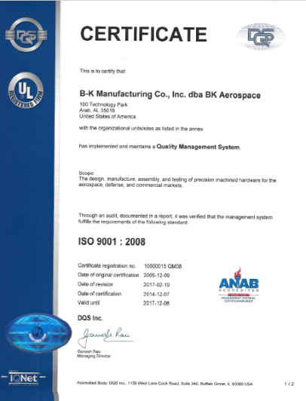
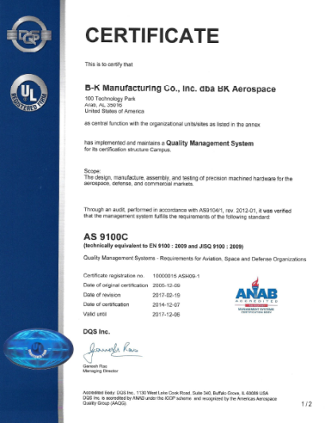
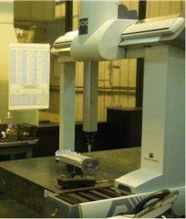
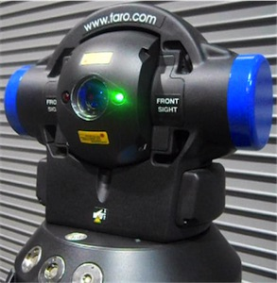
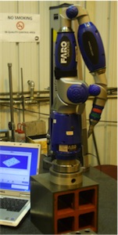
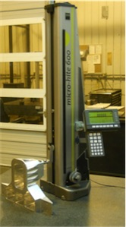
Quality System
Meeting and/or exceeding customer demand is our top
priority here at BK.
BK’s quality system is 3rd party registered and certified to ISO 9001 and AS9100 for Design, Manufacturing, and Testing.
BK has invested in high-precision, state of the art scanning and measurement equipment.
Inspection is carried out in temperature and FOD controlled areas.

Slide 9
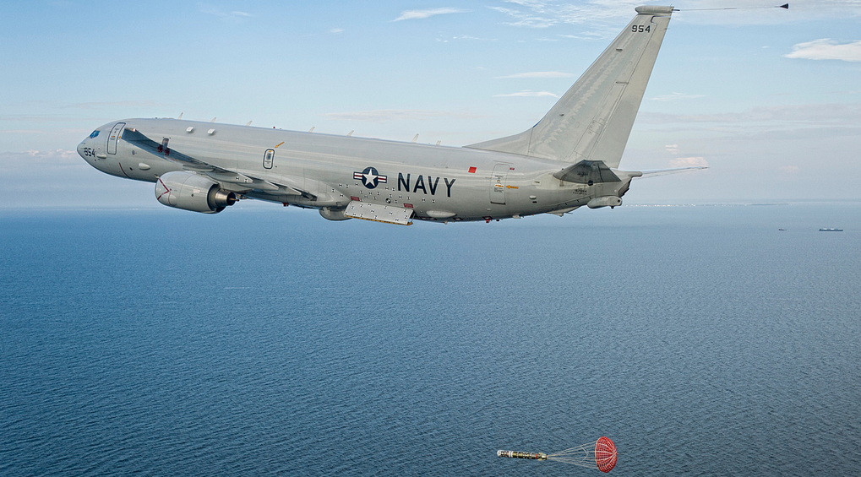
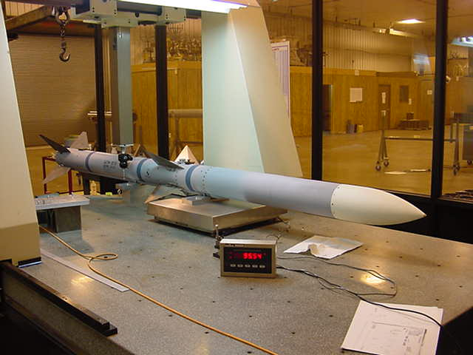
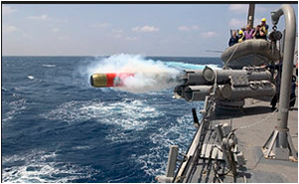
Some of Our Quality Products
P8 Poseidon Bailout Door Assembly
AMRAAM CATM-120
MK-54 REXTORP
Tooling for the International
Space Station
NASA SLS Tooling and Hardware

Slide 10
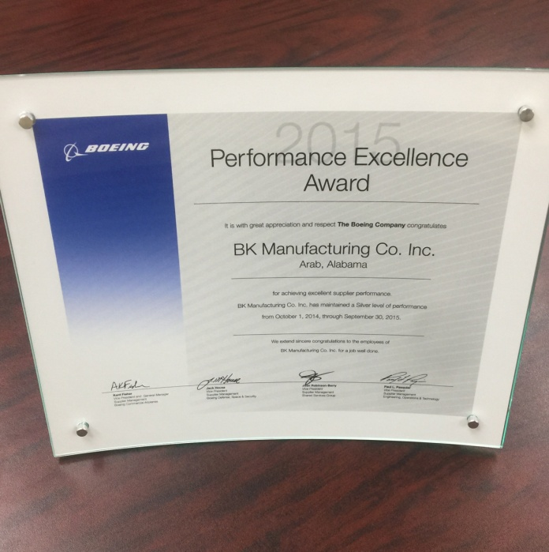
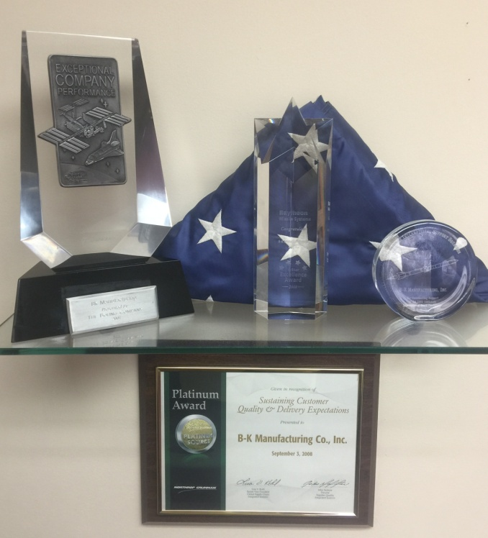
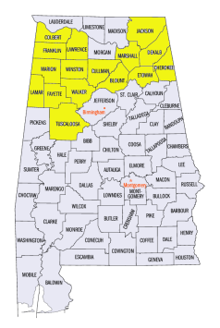
Awards and Customer Satisfaction
BK has received many letters of commendation on various
programs including AMRAAM with the U.S Air Force.
BK recently earned the Small Business of the Year Award with
Boeing, the Gold Supplier Award with Boeing and
has received the Performance Excellence Award
five years straight with Boeing.
- BK recently earned the Four Star Supplier Award with Raytheon
and the Platinum Award with Northrop Grumman.
- BK also has a good relationship with Congressman Robert Aderholt – R.AL 4th District

